Slide 1
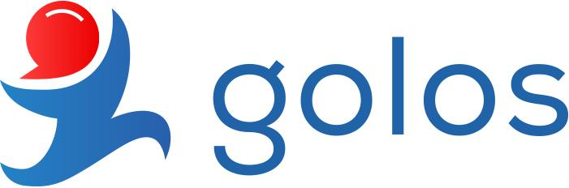
Media-based
Blockchain Platform

Slide 2
Media-based
Blockchain Platform
25,000 TX / day | 150,000 Users | 30+ Applications
 | 100+ Nodes

Slide 3
The problem
Freedom of speech Censorship and moderation
Advertising Annoying and non erasable ads
Financial dependence People are tied to the traditional banking system
Proof of existence
To prove something we are dependent on the notariat
Low level of income
Income levels aren’t appropriate
Distance We are bound to distance even in our day and age

Slide 4
The solution
No adminstrator The user chooses which content to see and which is appropriate
P2P advertising Direct delivery of product from source to source
Freedom of finance Be your own bank, p2p monetizing
Digital era Everything is signed by your signature on origin on the blockchain
Additional income For third world countries it could be a lifesaver
No boundaries No more bound to fried lists, connecting people all over

Slide 5





Who is interested
Mass Media / communities
Earn extra money. Save on offices and personnel. Proof of ownership. Everlasting information.
Bloggers
Earn money on your content. Decide what to post. No tracing adverts.
Investors
Future technology. Yearly rate. Stable GBG token (tied to paper gold). Passive earning.
Government
Clarity of transactions. Statistical instruments. Registration instruments. Verification of voting, identity.
Developers
Develop your application and easily monetize it with open source code.

Slide 6
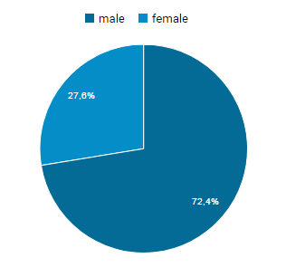
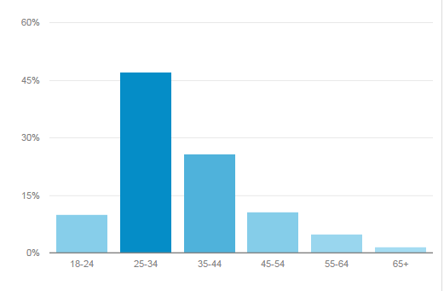
The market
Primary market is Russian speaking audience all over the globe
Russian speaking audience - circa 375 million

Slide 7

The future market
Secondary and future market: CIS countries and rest of the world
CIS population - circa 300 million

Slide 8


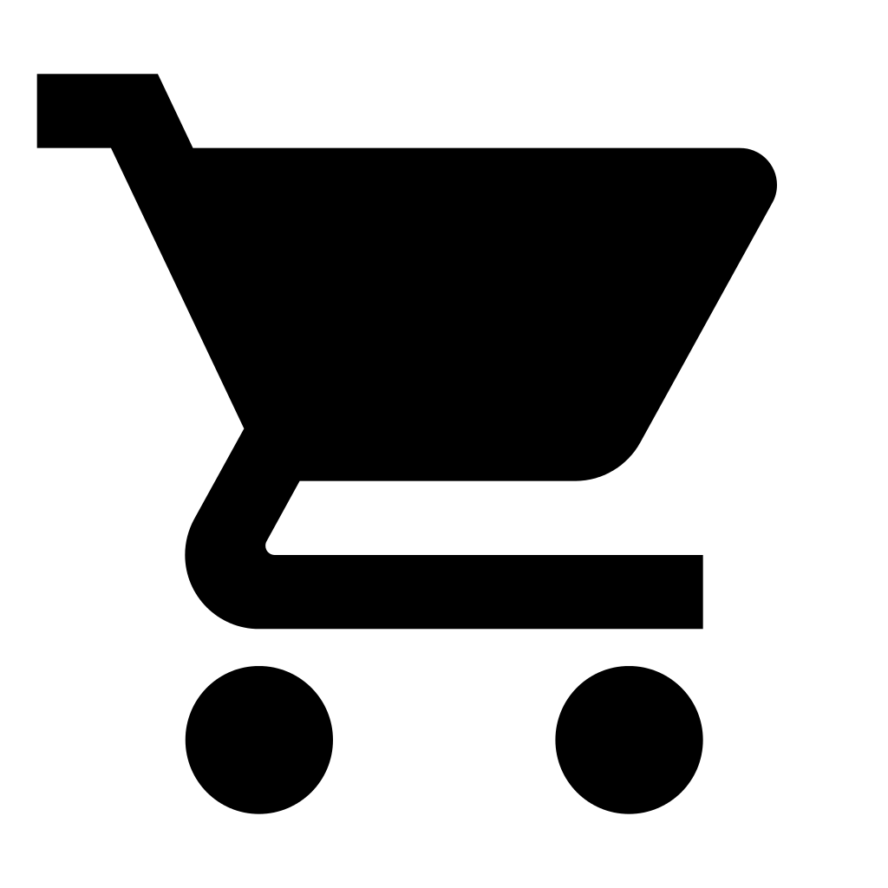
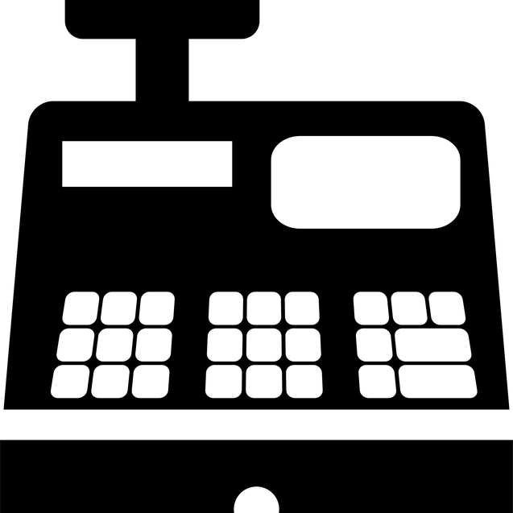
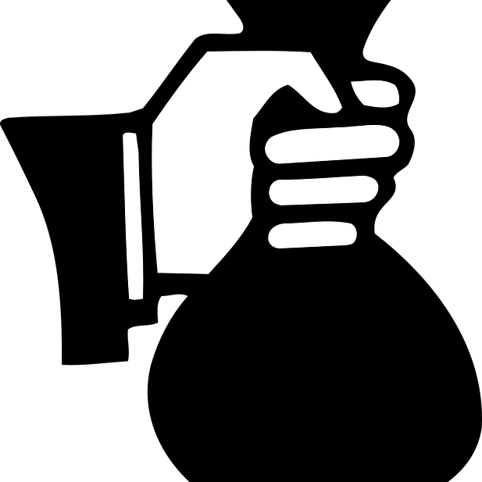
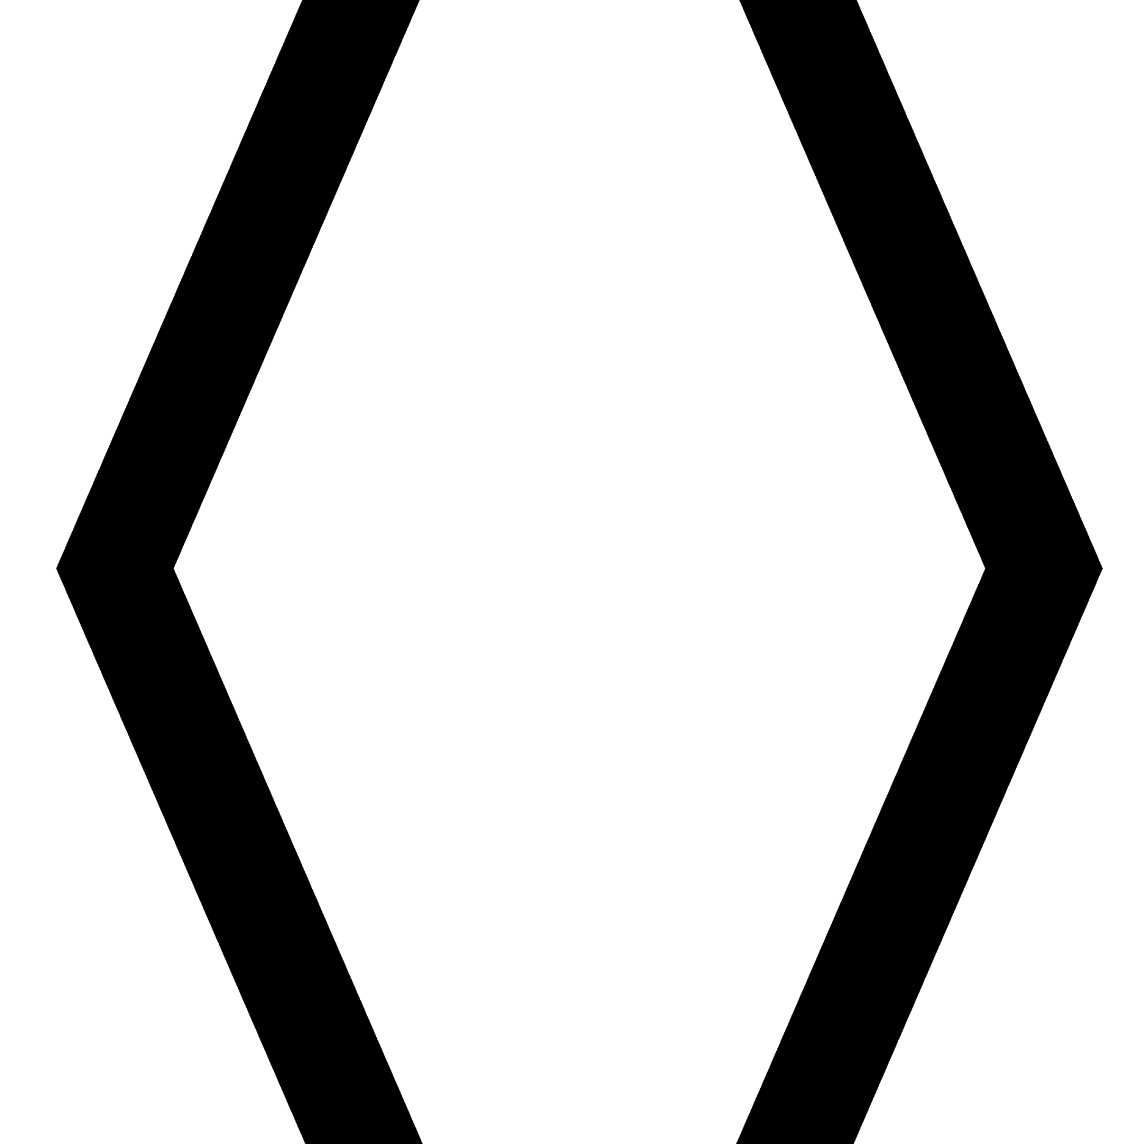
The model
Golos store
A typical app store that is free to use, but some extra modules may cost money.
Share in rewards
By giving most of the network to the peers, the applications takes back a cut to sustain itself.
Smart contracts
In the near future provide a place for peers to be able to make deals p2p (the application designs contracts).
Embedding
Embedding and consulting other applications that decide to work on the blockchain.
Private registrations
Applications allows completely private registrations for a small share.
Economical growth
Owning a certain share of the tokens, the model is based upon belief that the price will grow.

Slide 9
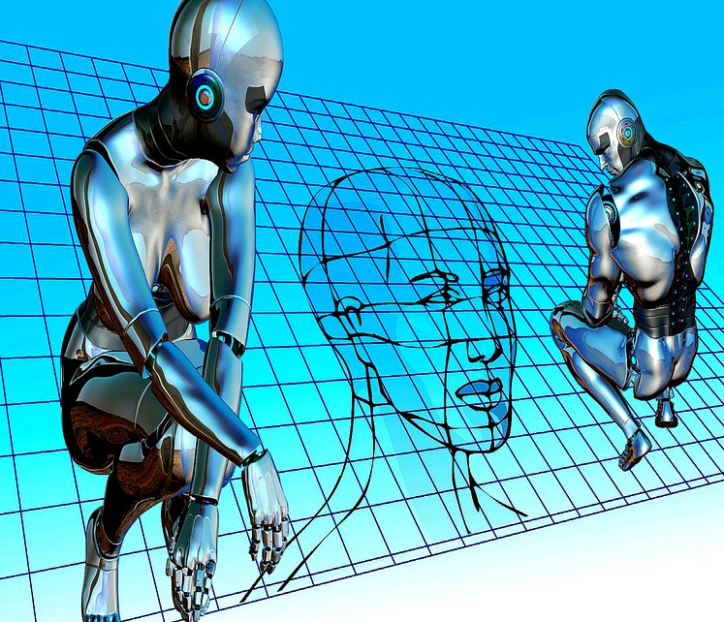
The technology
In upcoming release:
Multi signature accounts
Personal assets and smart coins
Language recognition
Shared code execution
Private messaging
Constant payouts
Payment routing

Slide 10
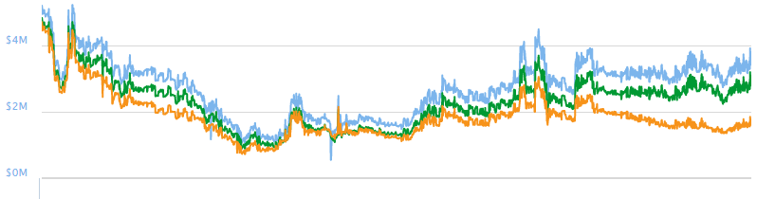
Funding
Received crowdfunding of just over 30 Mil RUB (one of the biggest in the RU net zone)
By means of smart investing, raised the fund to X2 the amount received (even with spending)

Slide 11
What we want to achieve
Market cap Raise the market cap of the application to the level of 100 mil USD
Applications Increase the amount of store apps to 500+
Dynamics Increase the network security by raising node consensus and amount of independent nodes to 500
Ecosystem
Increase the amount of .golos domains to 500+
Smart contracts
Introduce until 3rd quarter of the year and develop the platform in that direction
Technology
Find 50+ teams to work on the blockchain with their own applications

